Slide 1
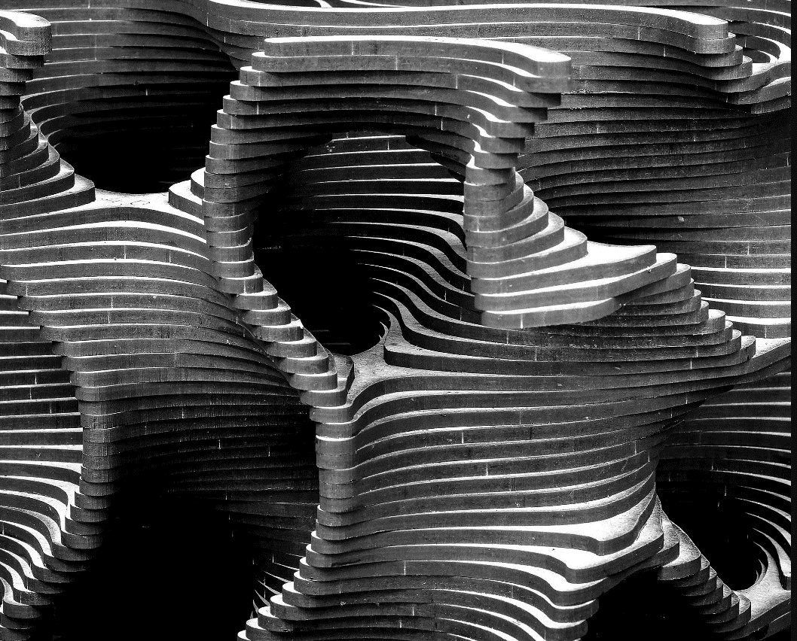
Design Optimization of Drone Arm
By
Naman Khetan Devyan Mishra Mudit Pathak Aryan Kumar
Pratik Mishra
Under the guidance of Prof. Pawan Sharma

Slide 2
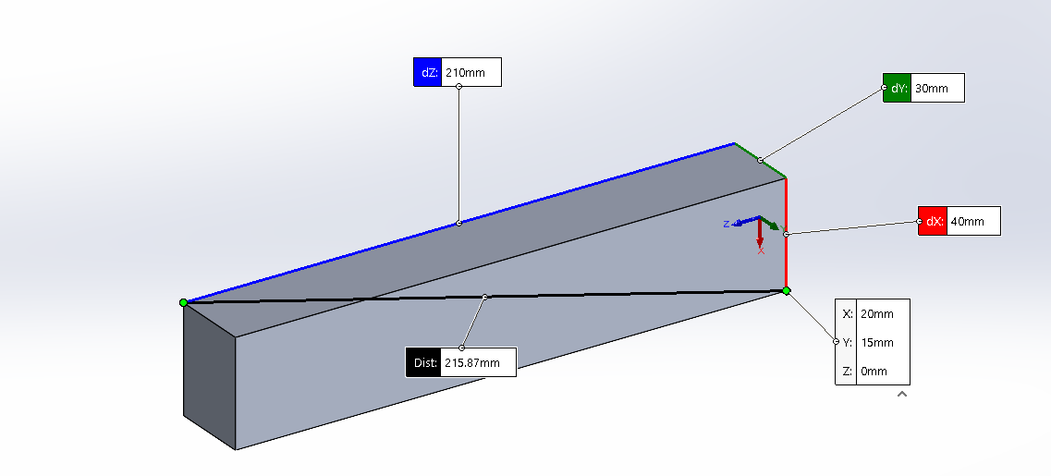
The Problem
We target the problem which is caused by heavy-weight drone arms. The issues with heavy weight in drone flight are as follows: -
The heavier the drone is, the more energy it requires to lift off and fly, which can reduce its flight time and maneuverability.
A heavier drone can also affect the stability and control of the drone, making it more difficult to operate in windy conditions or to perform precise maneuvers.
A heavier drone can also increase the risk of damage in the event of a crash or collision, potentially causing greater damage to the drone and any objects or people it may collide with.
CAD model of usual drone arm and its dimensions

Slide 3
Our Idea
Our idea was to make CAD models of drone arm using SOLIDWORKS and then optimized its design using simulation software like ANSYS using Finite Element Analysis (FEA). Below is the flowchart of our planning.
Making CAD model of drone arm using SOLIDWORKS
Do topology optimization analysis in ANSYS to reduce weight
Using topology optimized structures like gyroid
Do stress strain analysis in Ansys Structural using Finite Element Analysis(FEA)
Do stress-strain analysis in ANSYS using Finite Element Analysis(FEA)
Comparison with usual drone beam

Slide 4
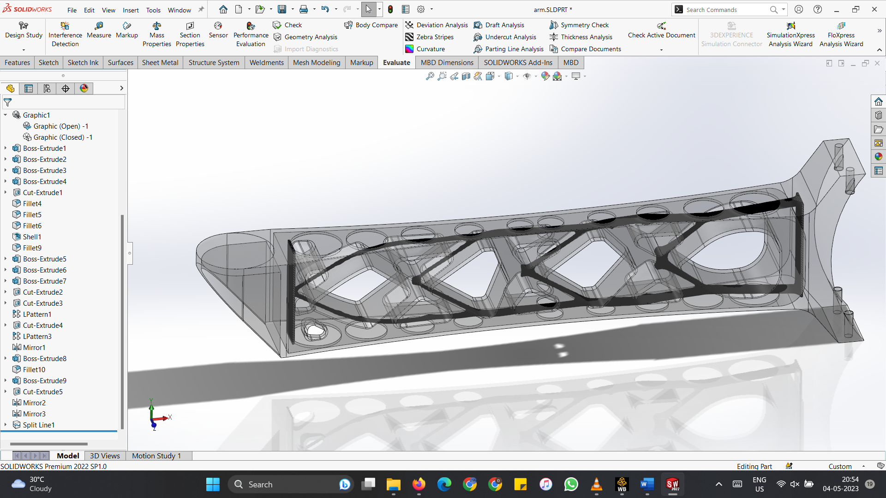
Topologically optimized drone arm CAD Model

Slide 5
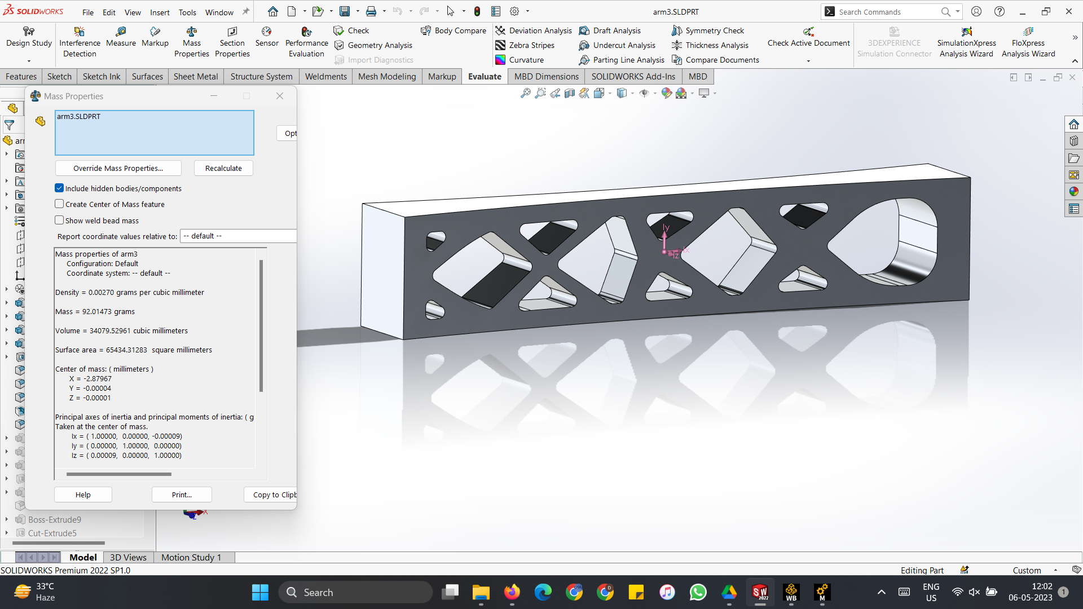
Topologically optimized drone arm CAD Model

Slide 6
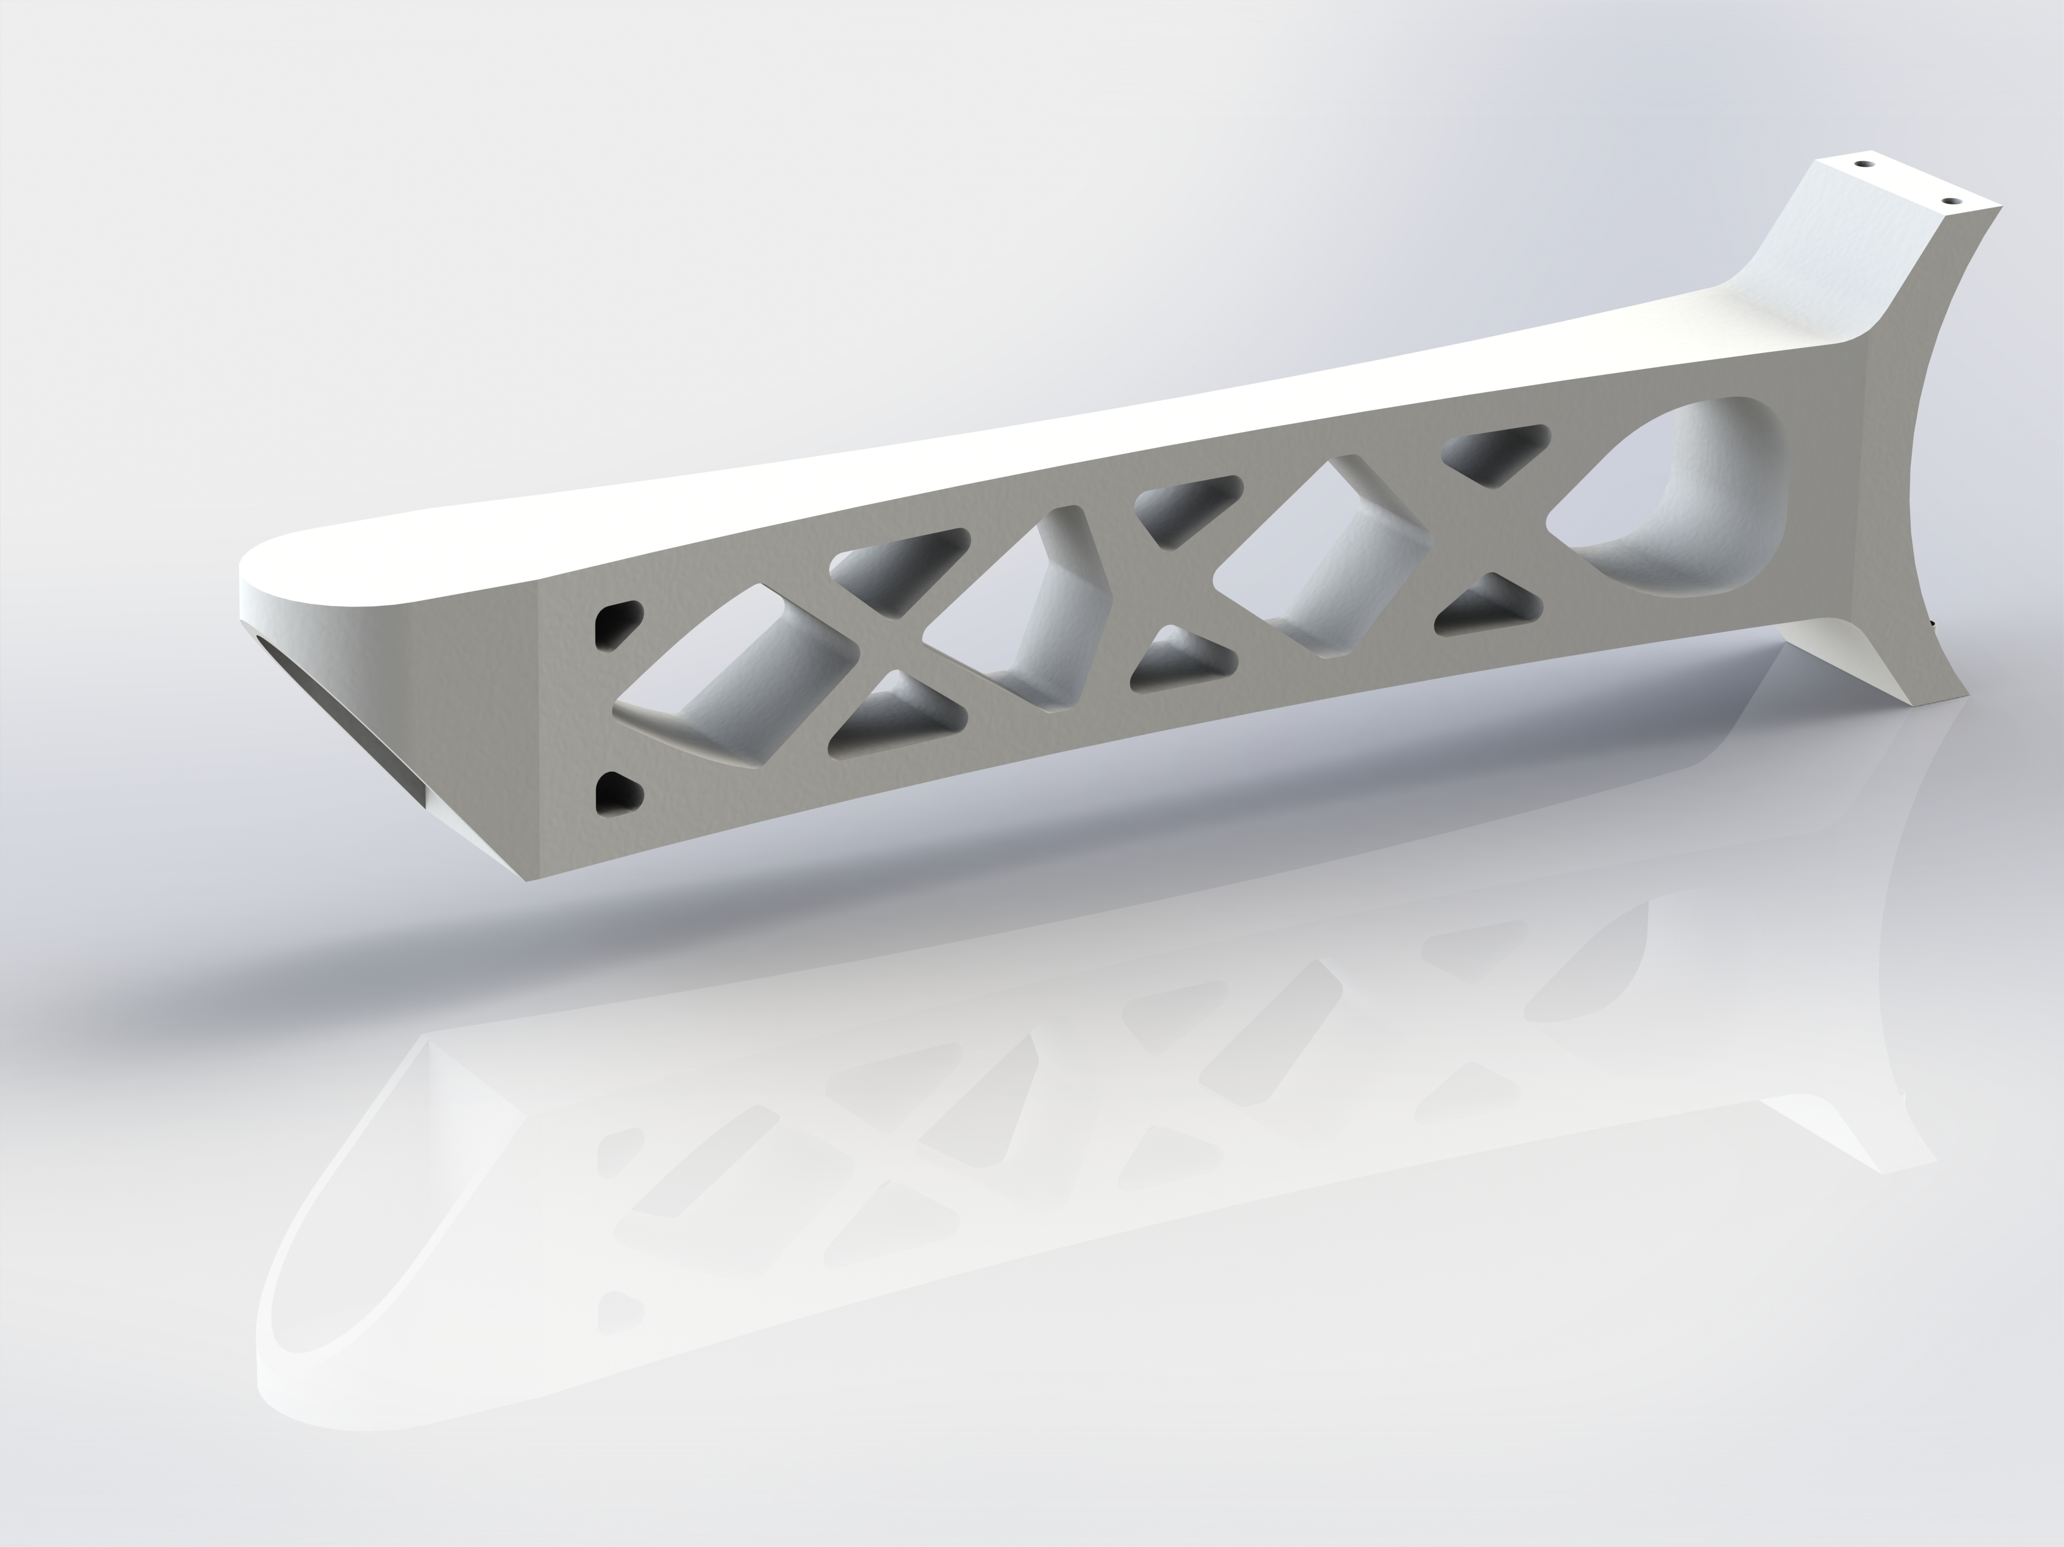
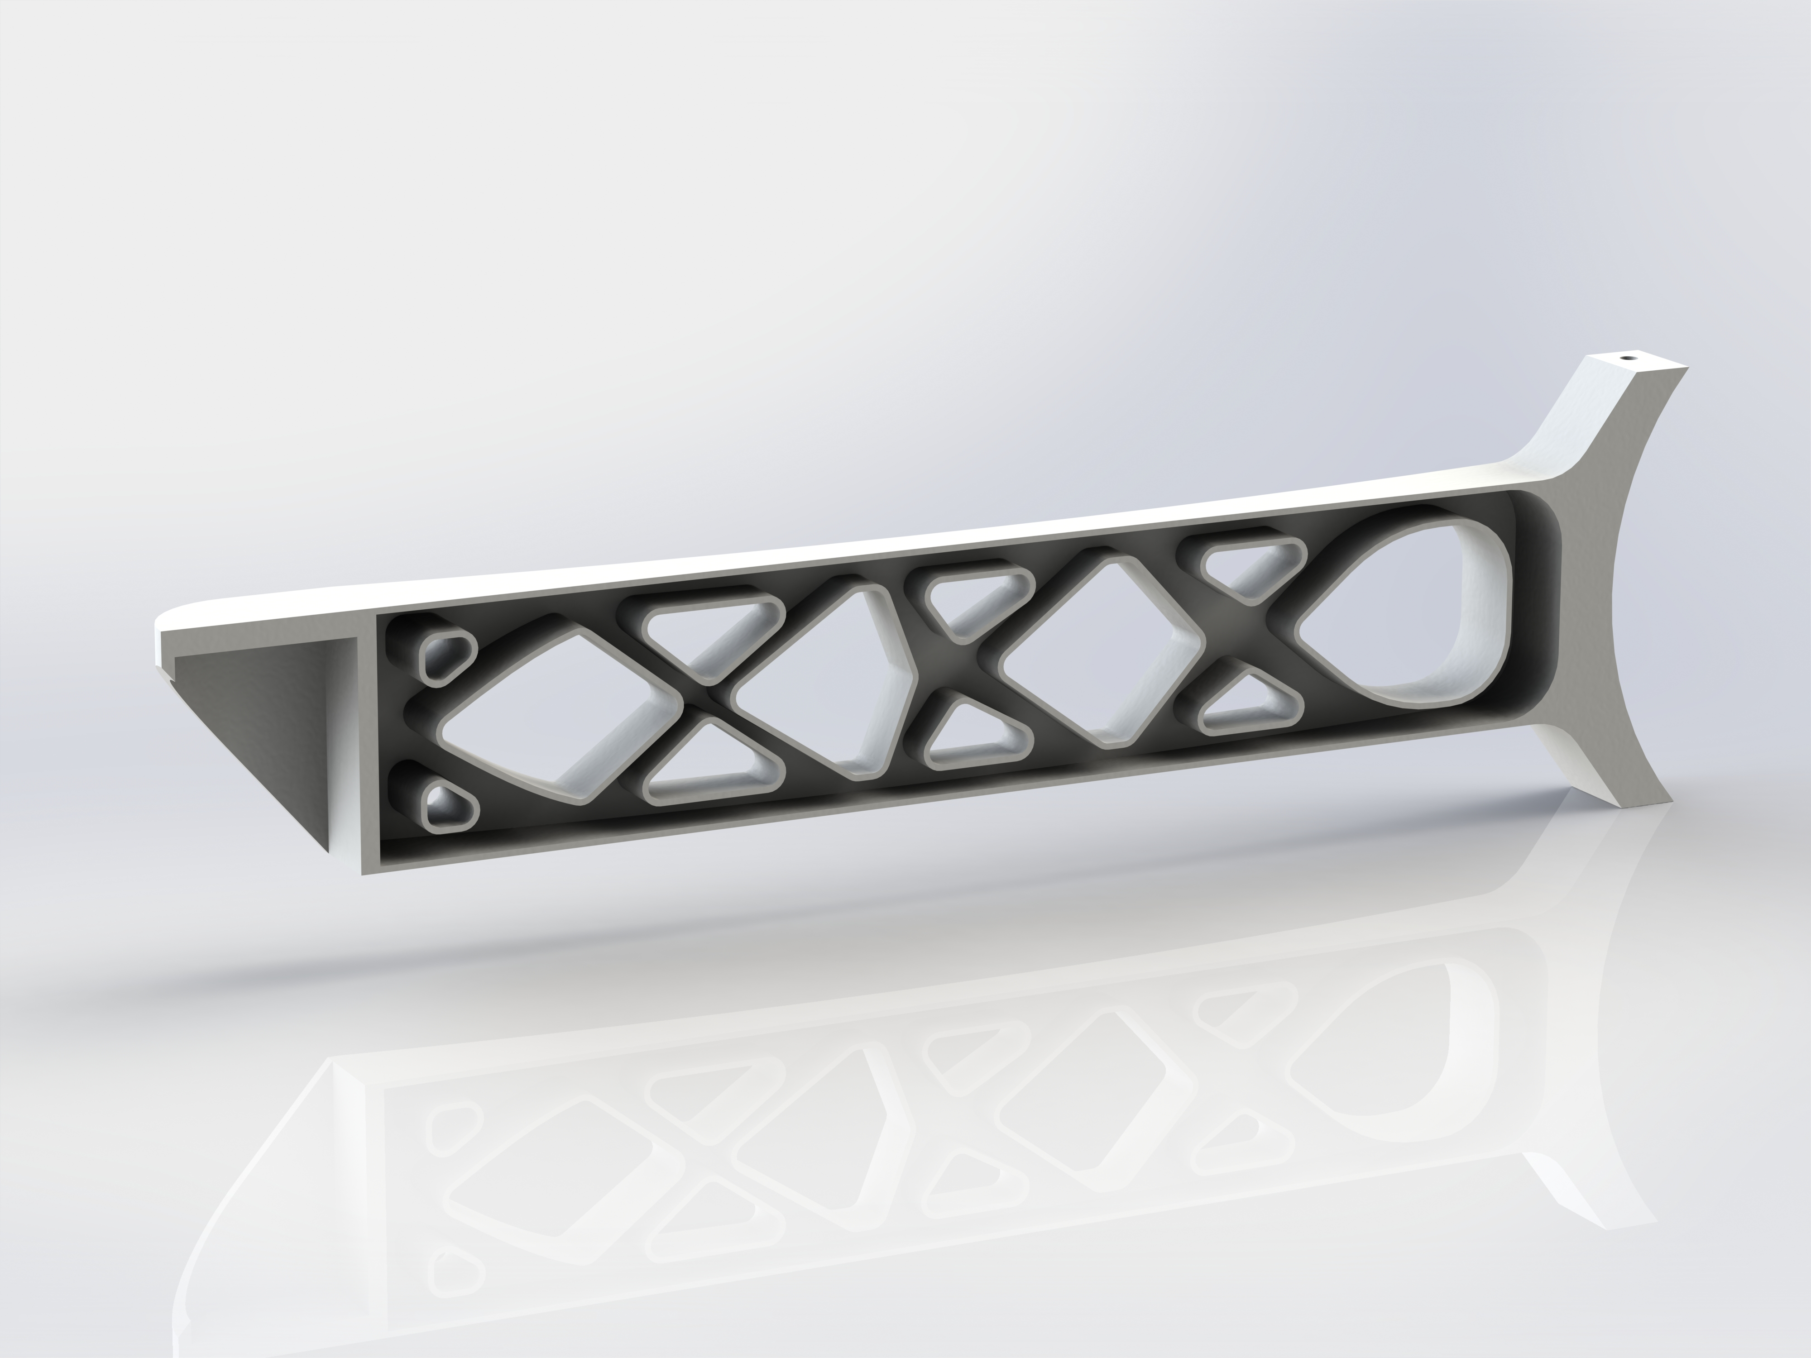
Topologically optimized drone arm CAD Model

Slide 7
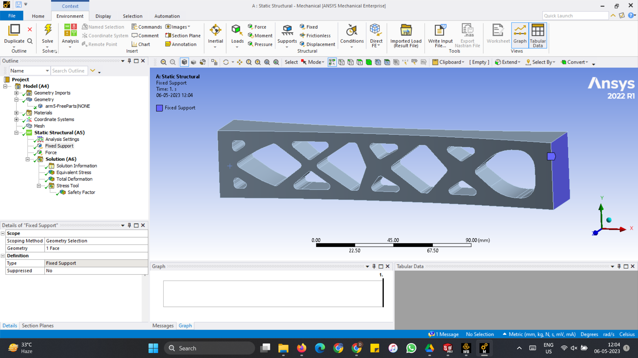
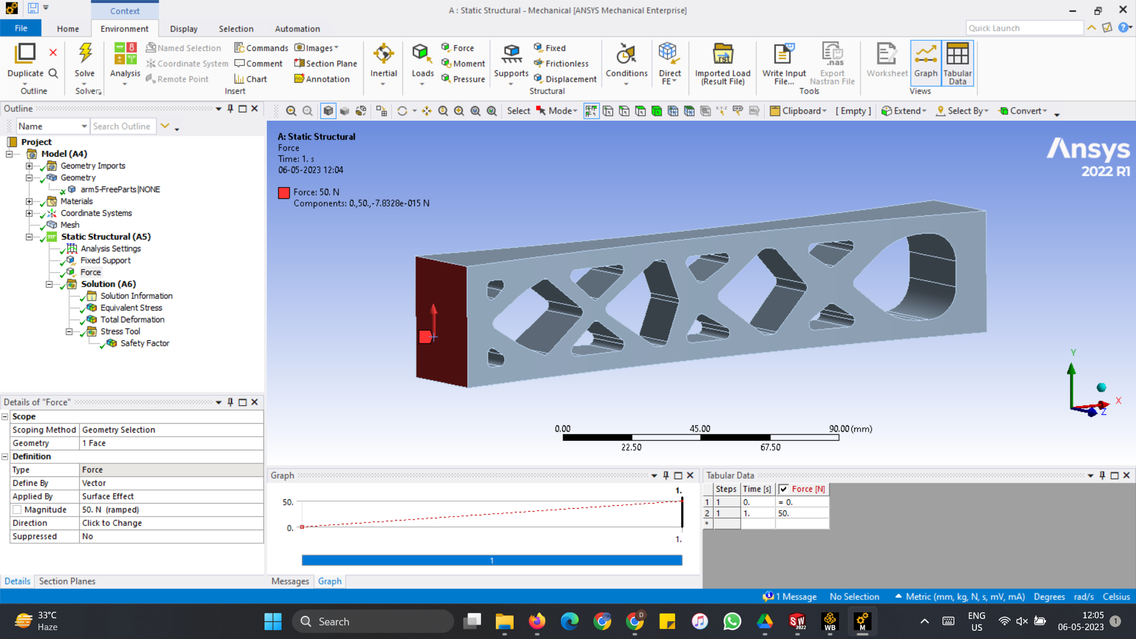
Ansys Structural Analysis

Slide 8
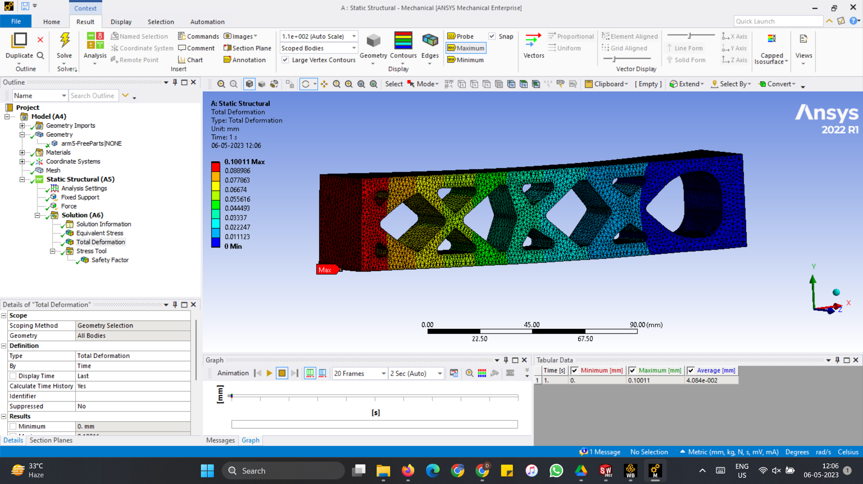
Ansys Structural Analysis

Slide 9
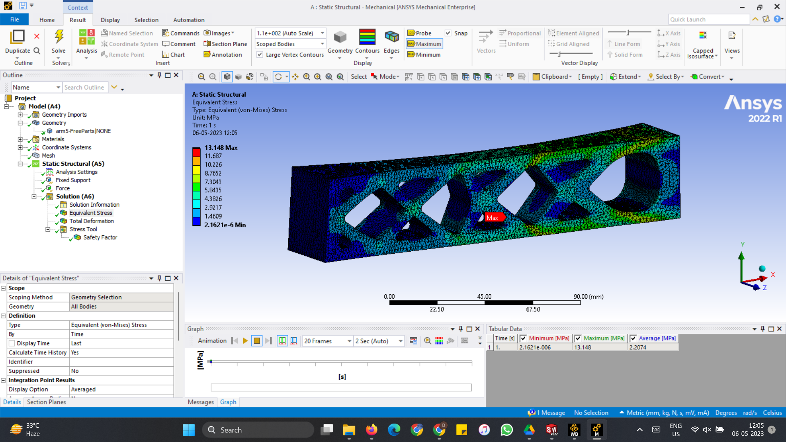
Ansys Structural Analysis

Slide 10
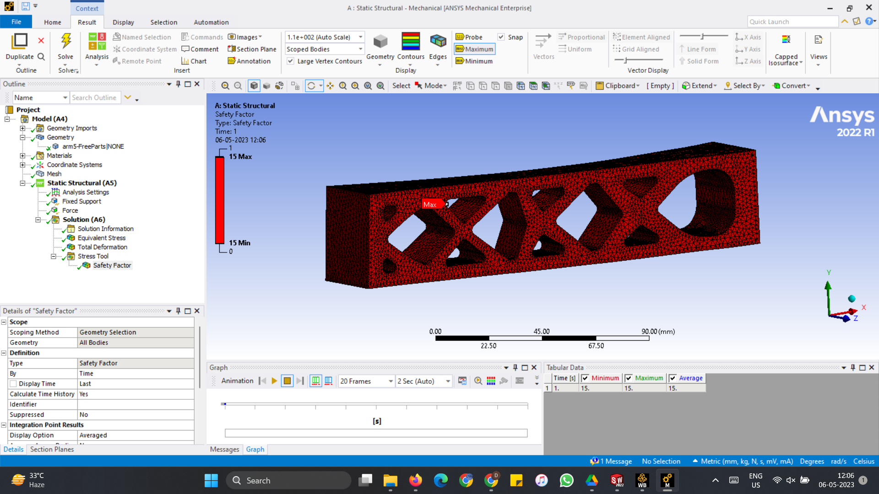
Ansys Structural Analysis

Slide 11
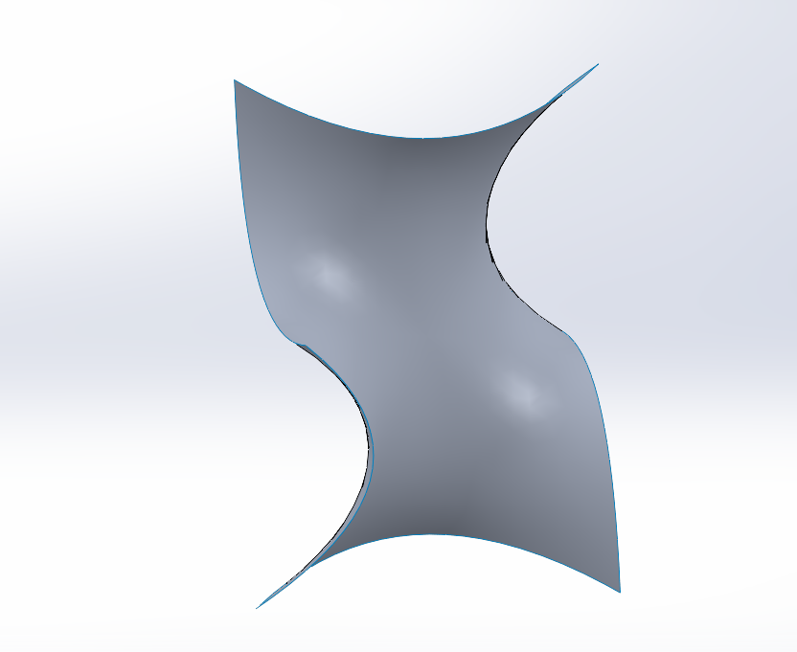
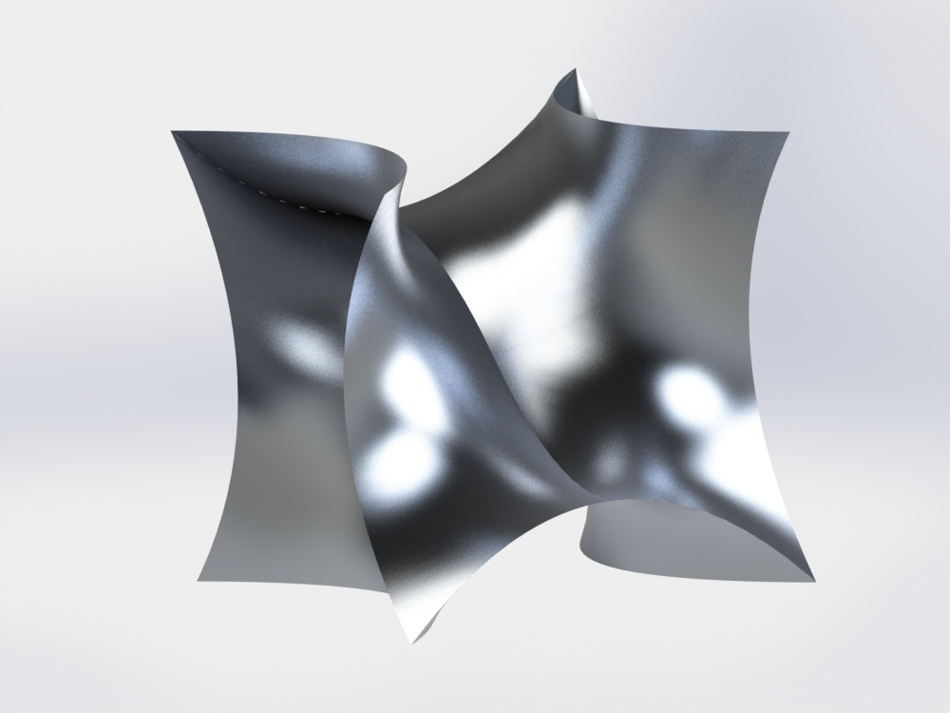
CAD Model using Gyroids
What are gyroids ?
Gyroid structures are complex, three-dimensional structures that are characterized by their repeating patterns of interconnected, curved surfaces. They are often found in nature, such as in certain types of corals. One notable feature of gyroid structures is their high surface area-to-volume ratio, which makes them useful for wide range of applications.

Slide 12
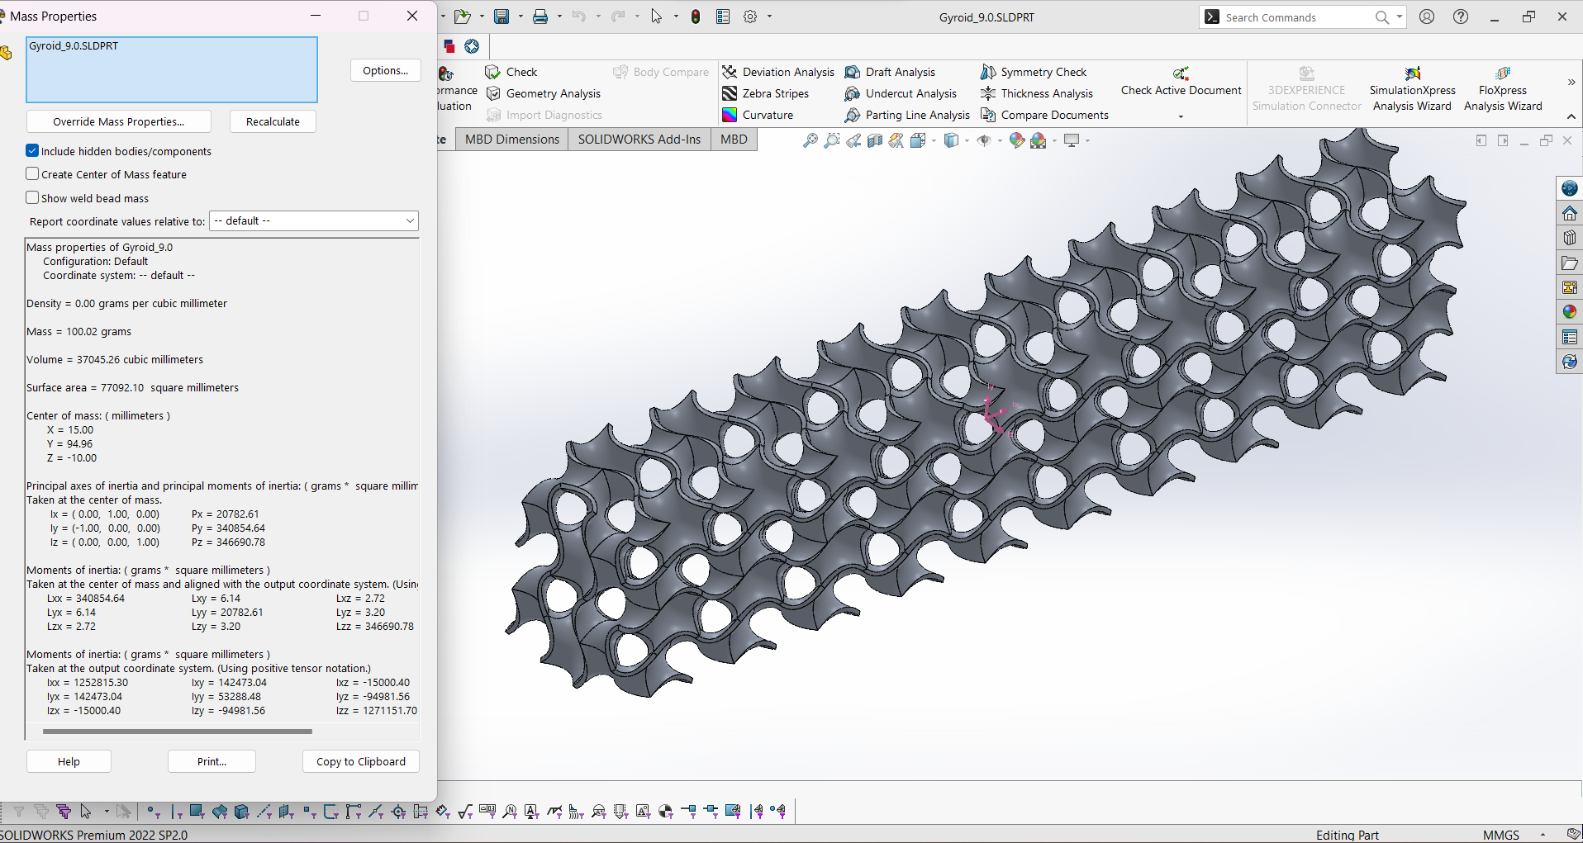
CAD Model using Gyroids

Slide 13
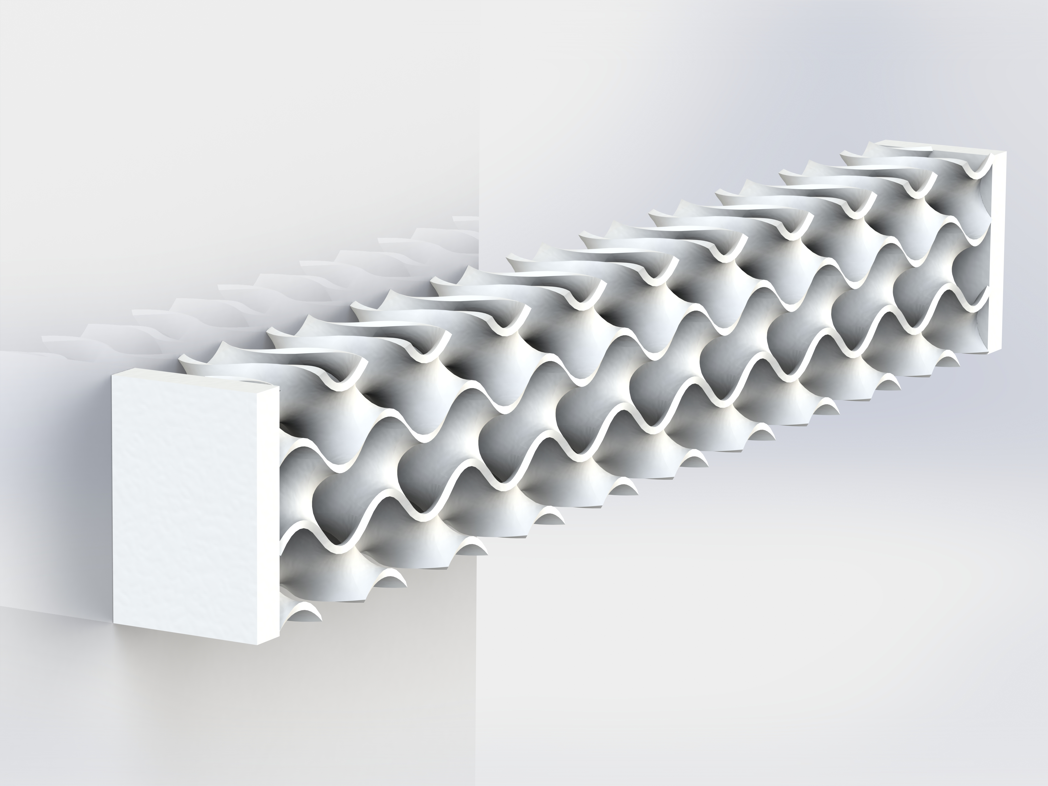
CAD Model using Gyroids

Slide 14
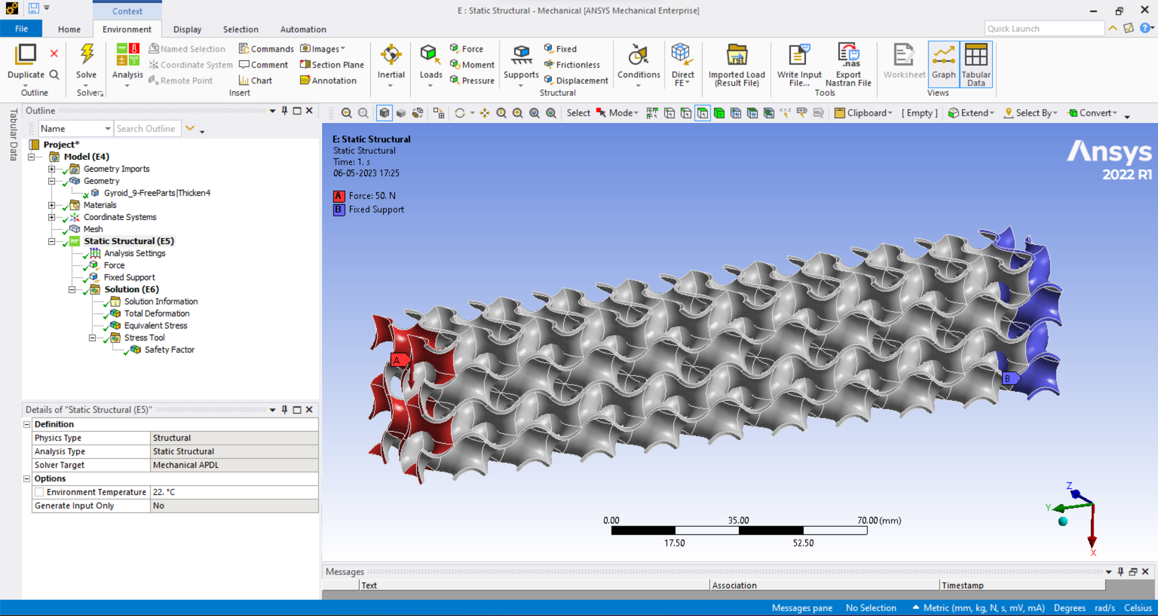
Ansys Structural Analysis

Slide 15
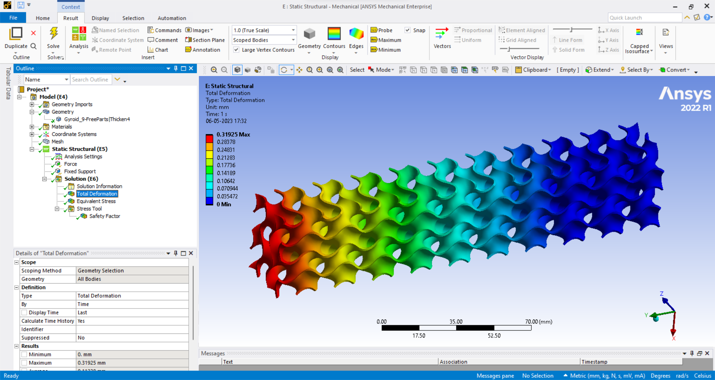
Ansys Structural Analysis

Slide 16
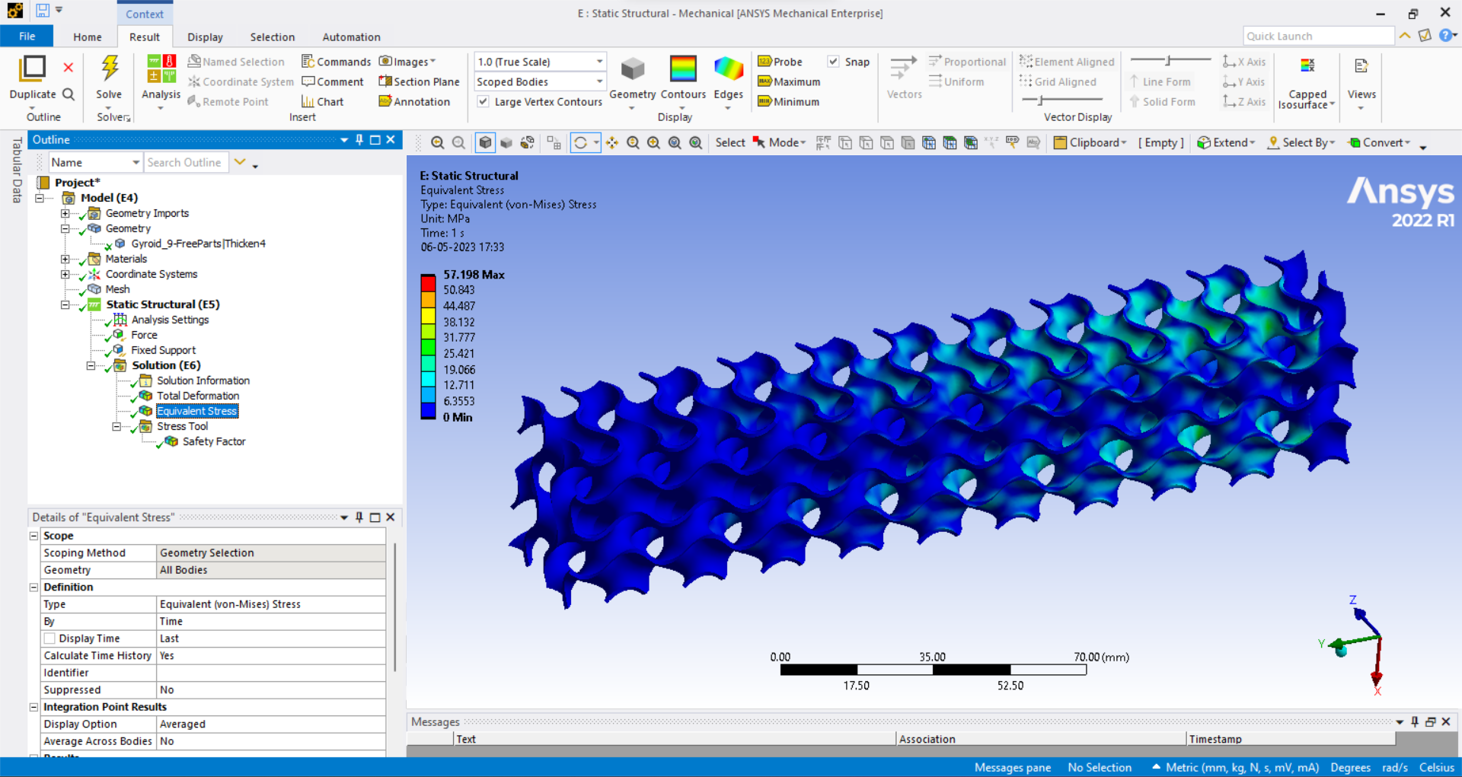
Ansys Structural Analysis

Slide 17
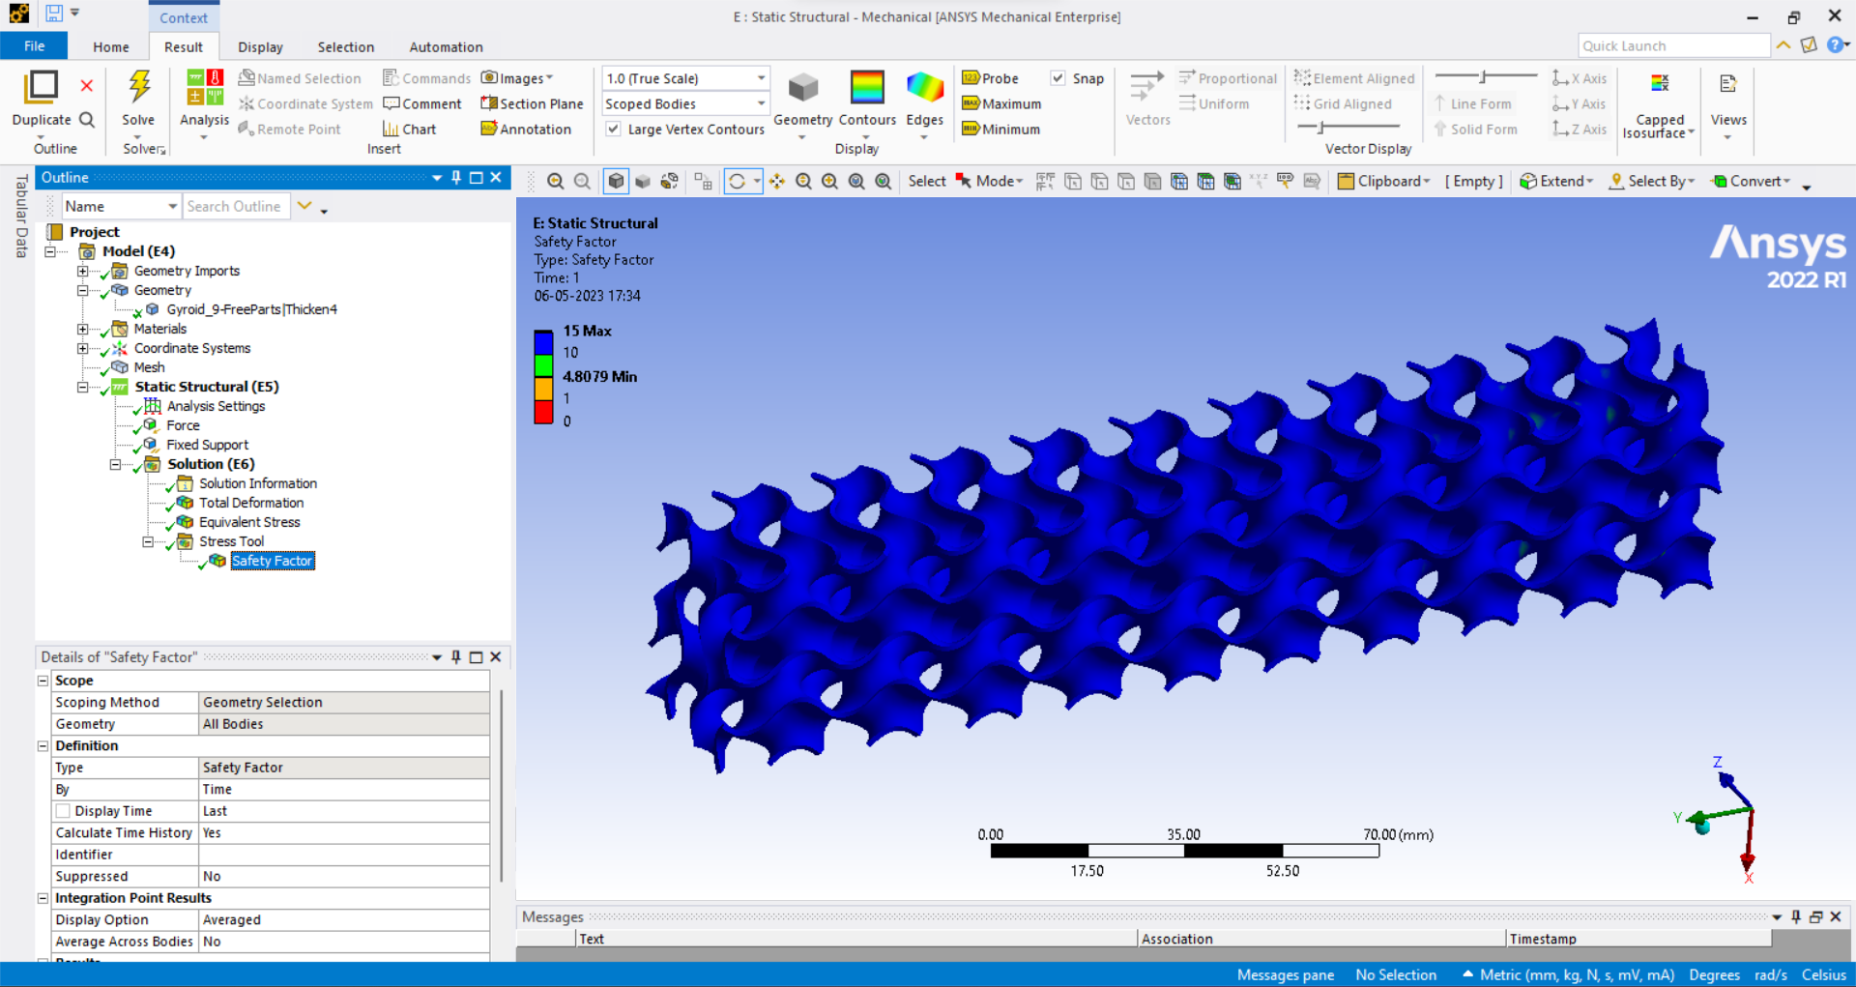
Ansys Structural Analysis

Slide 18
Comparison And Results
 | Weight (grams) | Maximum Deformation (mm) | Stress(average) (MPa) | Factor of Safety (average) | Factor of Safety Weight
Standard Drone Arm | 680.4 | 0.01 | 1.585 | 15 | 0.022
Drone arm with gyroids | 100.2 | 0.319 | 28.599 | 9.9 | 0.098
Topologically optimized drone arm | 113 | 0.100 | 6.574 | 15 | 0.133

Slide 19
Challenges We Faced
Design optimization is a new and vast field for us . We try to explore this field and applying it in design of drone arm . These are the problems we faced : -
Designing of gyroid and its analysis prove to be problematic due to software limitations .
Topology optimization analysis in ANSYS don’t work on non linear materials, due to this limitation we are not able to test drone arm by using materials like carbon fibre which are non linear in nature.
Future Works
We have discusses among ourselves about how to approach this project for future progress. These are our ideas: -
We are thinking to learn more about other simulation softwares to have better analysis results . This is will allow us to present our design optimization results in competitions.
We are looking to 3D print all three CAD models and do its analysis to compare experimental and simulation results.

Slide 20
References
https://www.sciencedirect.com/science/article/pii/S2214860422004432 – Presence of gyroid in nature
https://www.researchgate.net/publication/364952848_Metal_functionally_graded_gyroids_additive_manufacturing_mechanical_properties_and_simulation - Parameters of gyroid structure
https://www.ncbi.nlm.nih.gov/pmc/articles/PMC6947257/ - Assembly of gyroid cells in butterfly wings
http://www.personal.psu.edu/users/a/p/apm5502/LMProjectReport.pdf – Usage of gyroids in Martin Lockheed
Thank You

